Slide 1
Share Price Prediction
Ravikant B Hatwar

Slide 2
RNN and LSTM
We are interested in predicting stock price.
In this capstone project we are using deep learning techniques like RNN and LSTM
RNN : A powerful neural network used fro modelling sequential data. Ex Time Series, Natural Language Processing.
LSTM : A RNN memorises data points over longer period. It consists of a Cell, Input gate, Output gate and Forget Gate.

Slide 3
RNN and LSTM

Slide 4
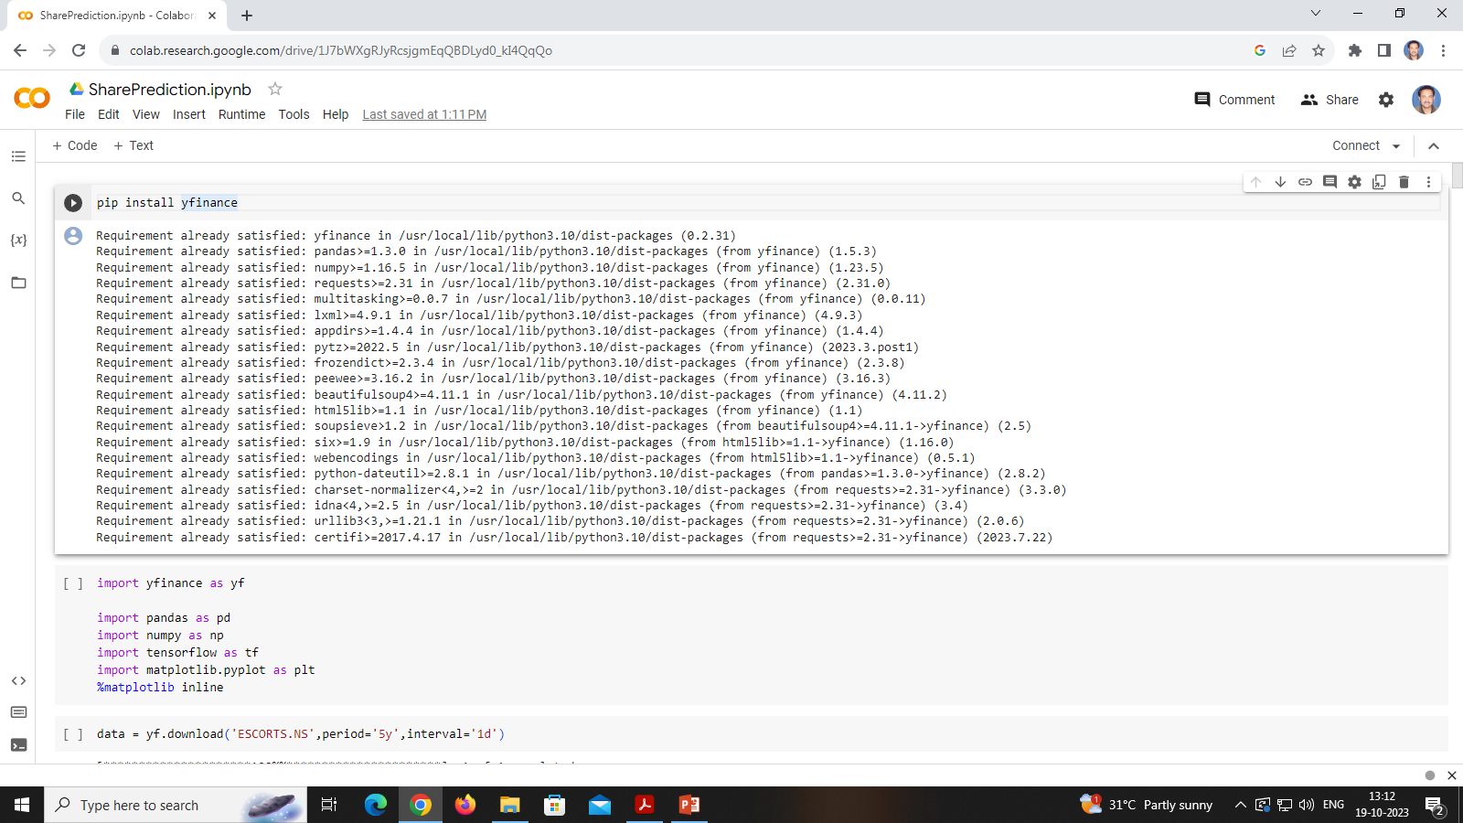
Data Collection and Pre-processing
In this project we will be using ESCORTS Ltd stock data from yfinance.

Slide 5
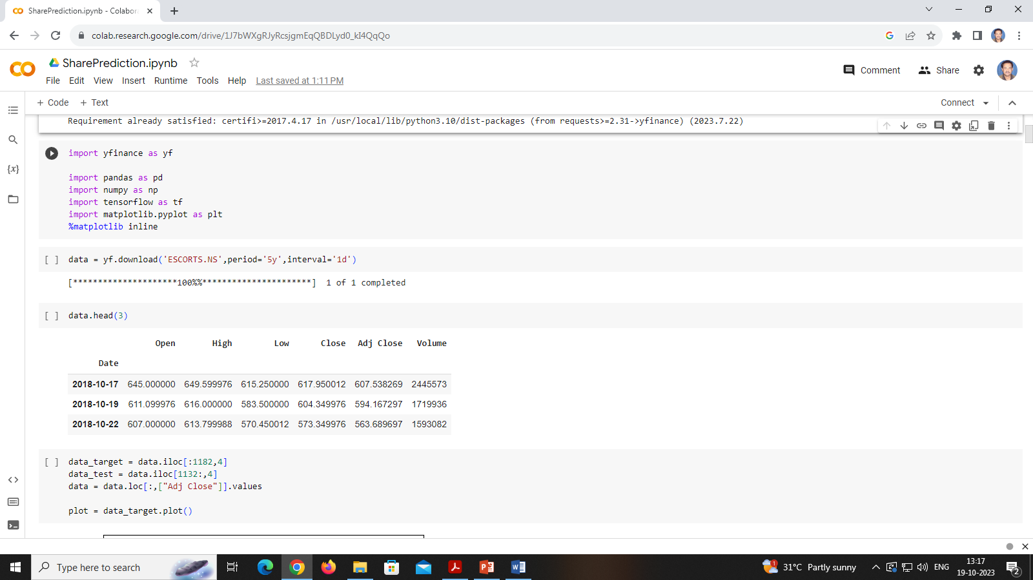
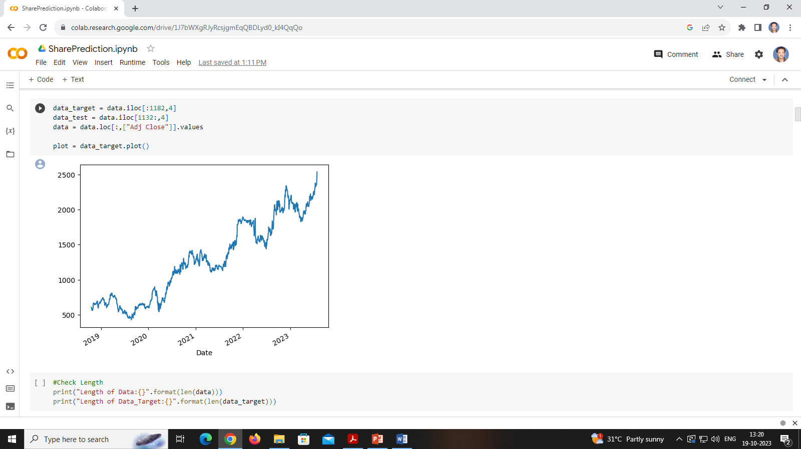
Data Collection and Pre-processing

Slide 6
Splitting Data : Train and Test Sets

Slide 7
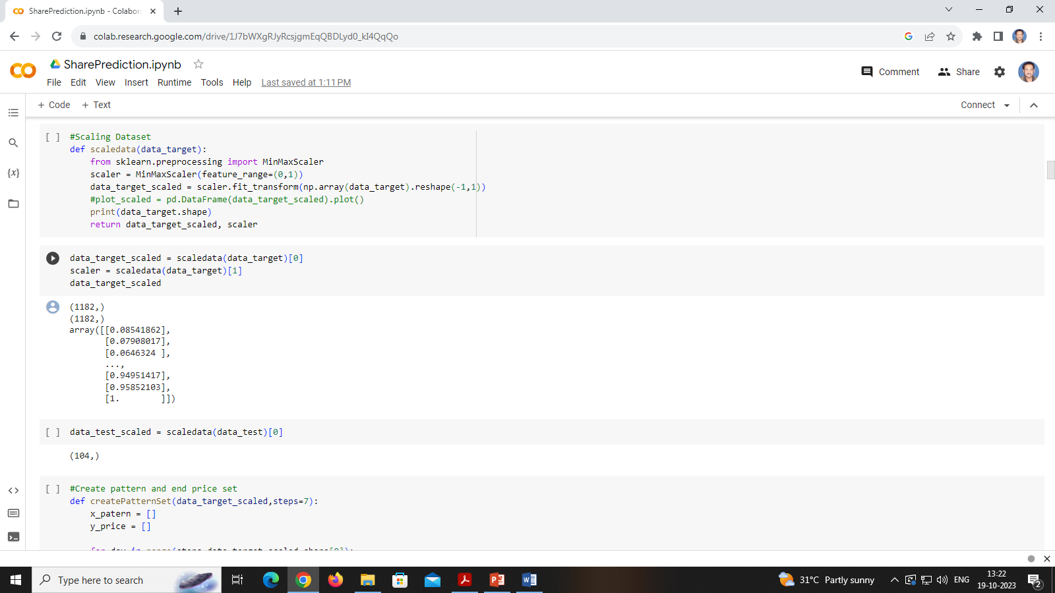
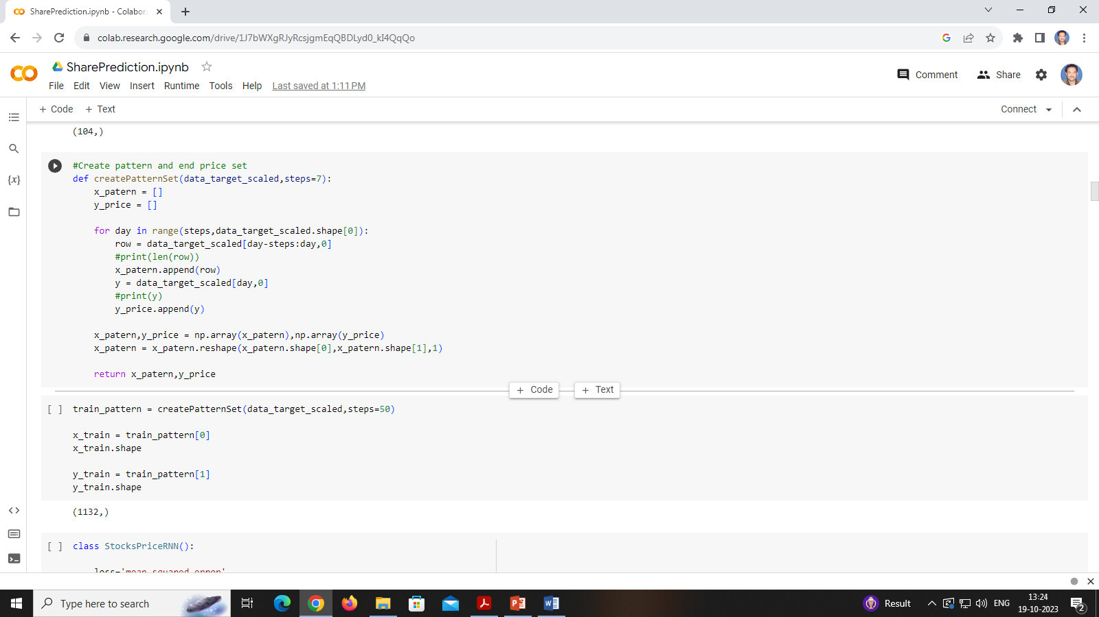
Data Scaling and Conversion

Slide 8
Train and Test Sets
We will use our function CreatePatternSet() to build x_train and y_train

Slide 9
Model Architecture

Slide 10
Model Architecture

Slide 11
Model Architecture

Slide 12
Class for LSTM

Slide 13
Visualization

Slide 14
Iterations and Evolutions

Slide 15
Evolutions

Slide 16
Conclusion
The model is capable of lot more iterations. We can try out with different hyper parameters and get closure to the original price curve.

